Slide 1


Slide 2
Step-by-step Guide on How to Use Laser Cutter (T1442)

Slide 3


Before you start laser cutting,
Program Requirement
You will need your Dxf profile. You can export dxf files from a lot of programs. The closest examples would be Fusion 360 and Corel Draw.
If you want to do raster engraving, make sure you have downloaded the picture with highest quality in order to have a good engraving.
Material Requirement
Make sure that you have sufficient material for your cut.
Take note of the type and thickness of the materials because different type or thickness means different cutting settings.

Slide 4
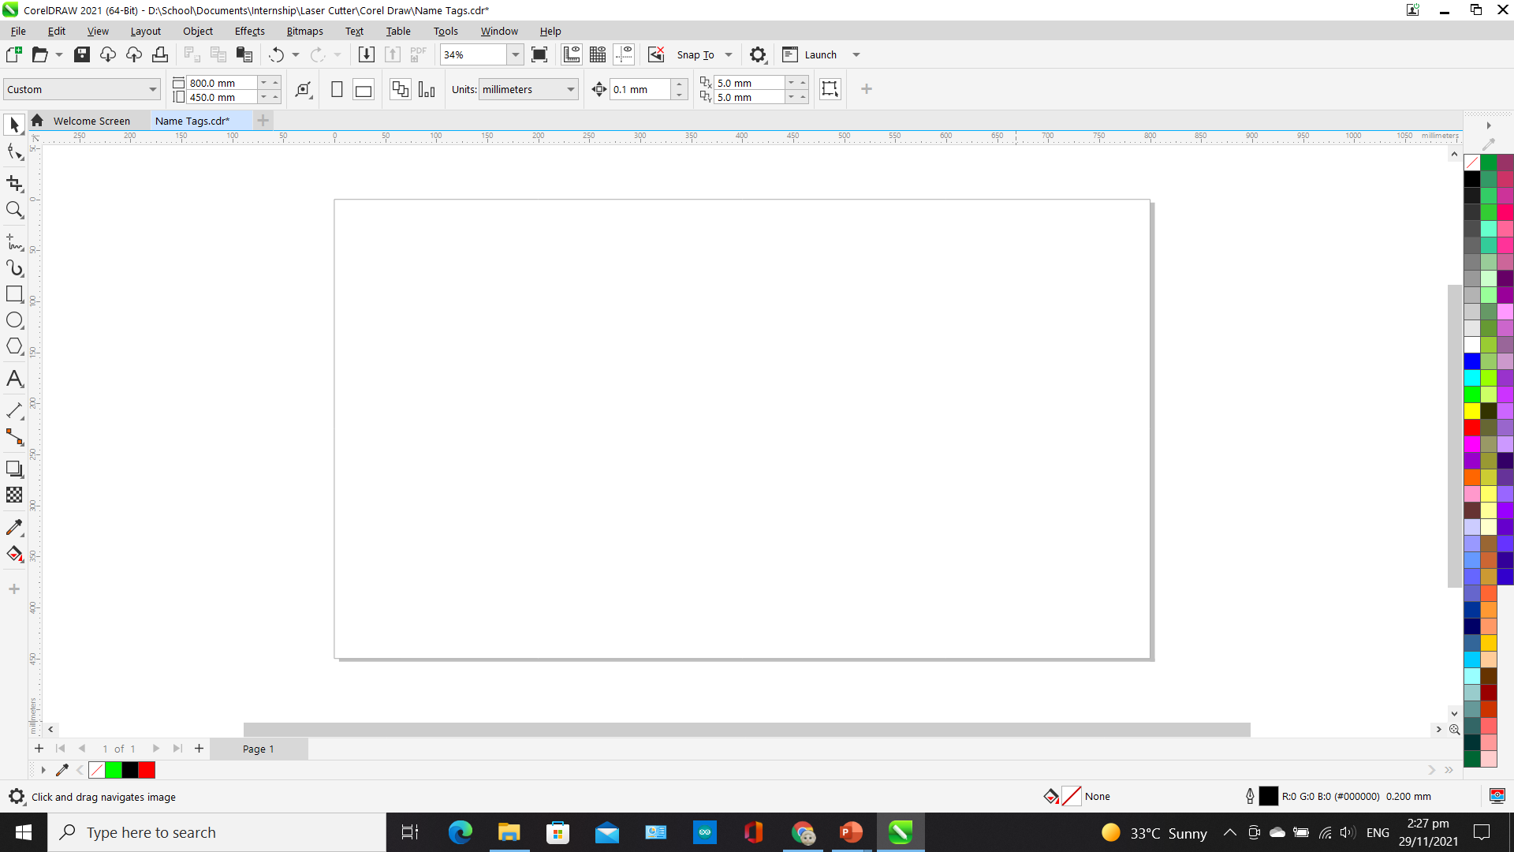
Step 1
Open Corel Draw. You will see a blank canvas.
Note: Do not resize the canvas size for the laser cutter because the canvas size is equal to the working space of the laser cutter.

Slide 5
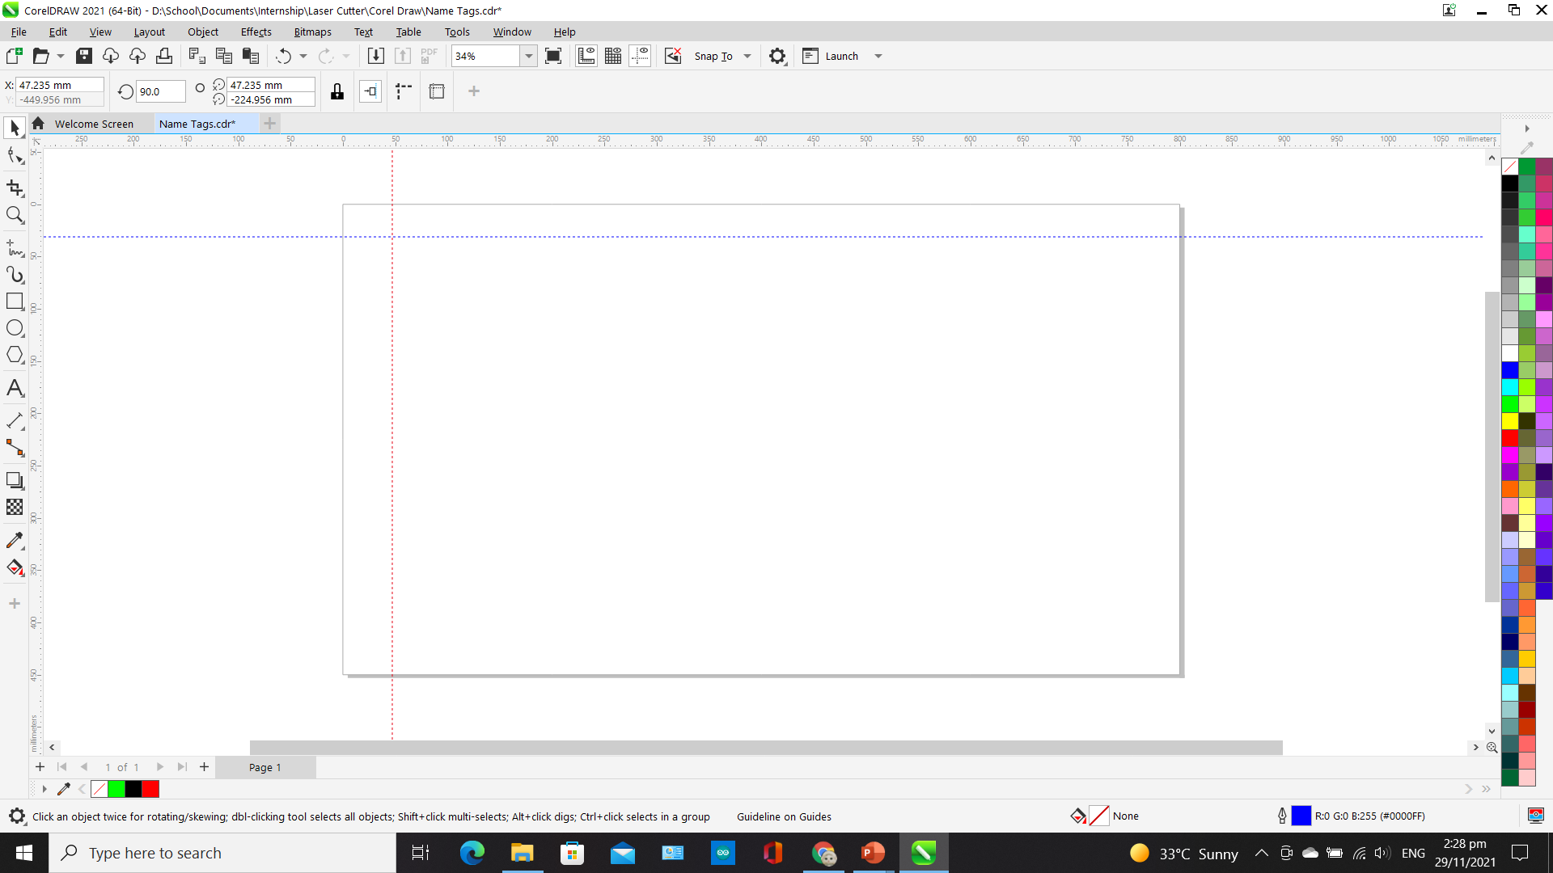
Step 2
Draw guidelines. To do so, click on the rulers from the top and left and drag. There are two ways to place the guidelines. You can either place it manually by selecting the line and dragging or selecting it and putting in the coordinates at the top left box. (Place them at approx. 5mm, 5mm from top left corner).)
Coordinates
Guidelines
Note: The guideline in red is the one that has been selected.

Slide 6
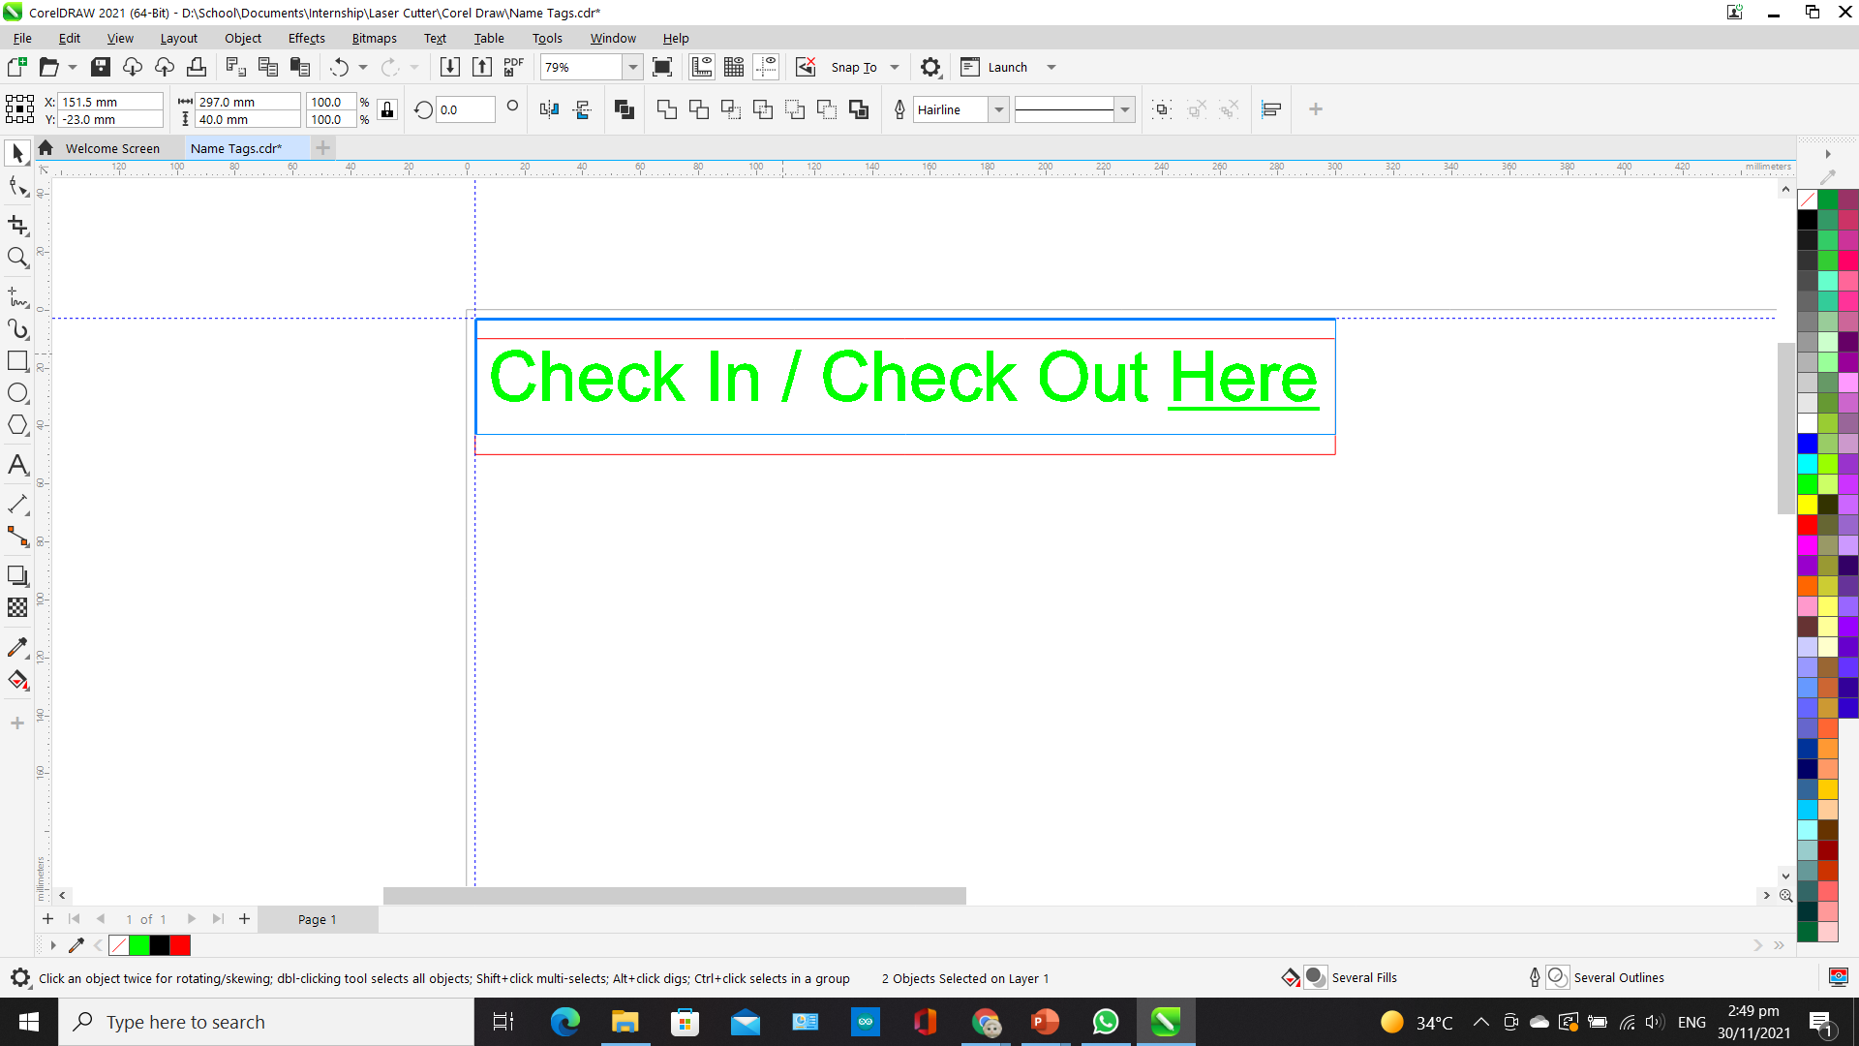
Step 3
Import your file and position it to the guidelines. If the design is not snapping to the guidelines, make sure that the “Guidelines” box is ticked under “Snap to”.
Snap Lines

Slide 7
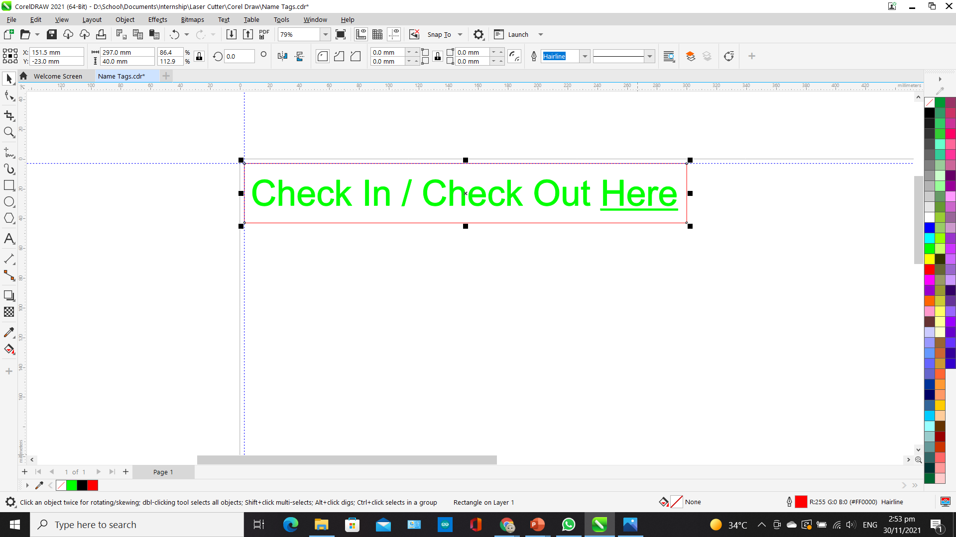
Step 4
Before printing, make sure that your profiles are correct. For cutting, you put the thickness to “Hairline” and change line color to red. For engraving, you use green, and thickness is put to any other thickness other than “Hairline”.
Change Infill Color Here
Change Line Color Here

Slide 8
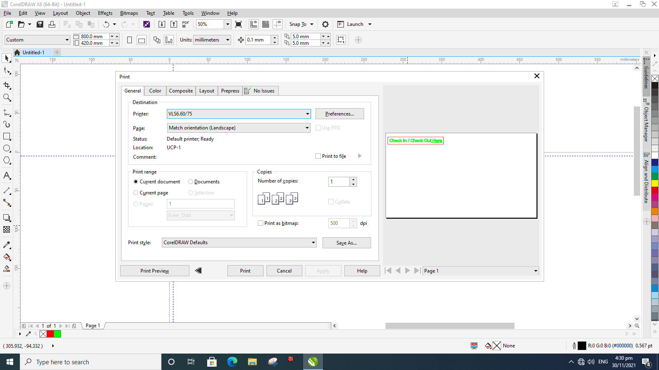
Step 5
If you are satisfied with the drawing position, click “Print”. A pop up will appear. Click “Preferences” to change the cutting settings.

Slide 9
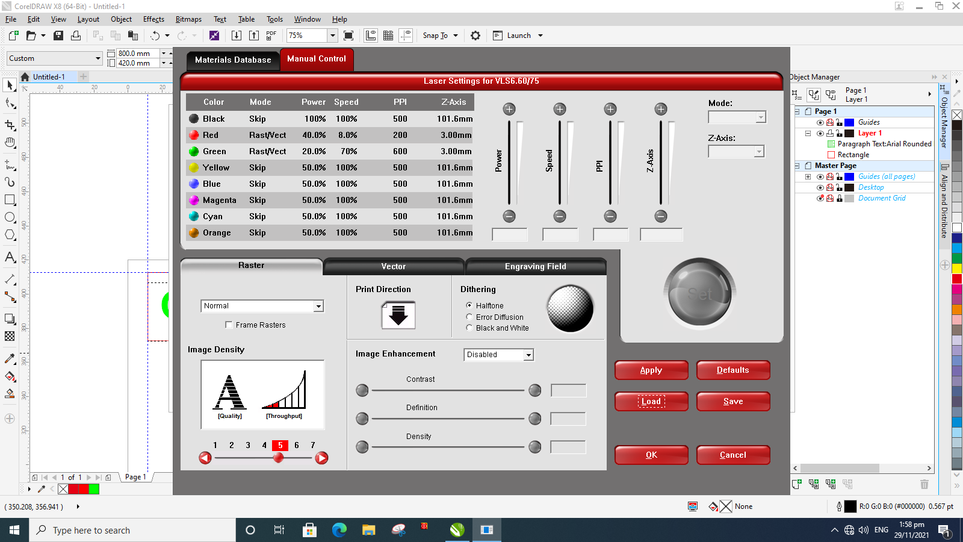
Step 5
In the settings, click “Load” to load the pre-set material settings. It is preferrable to use the pre-set settings if you are not familiar with the laser cutter.

Slide 10
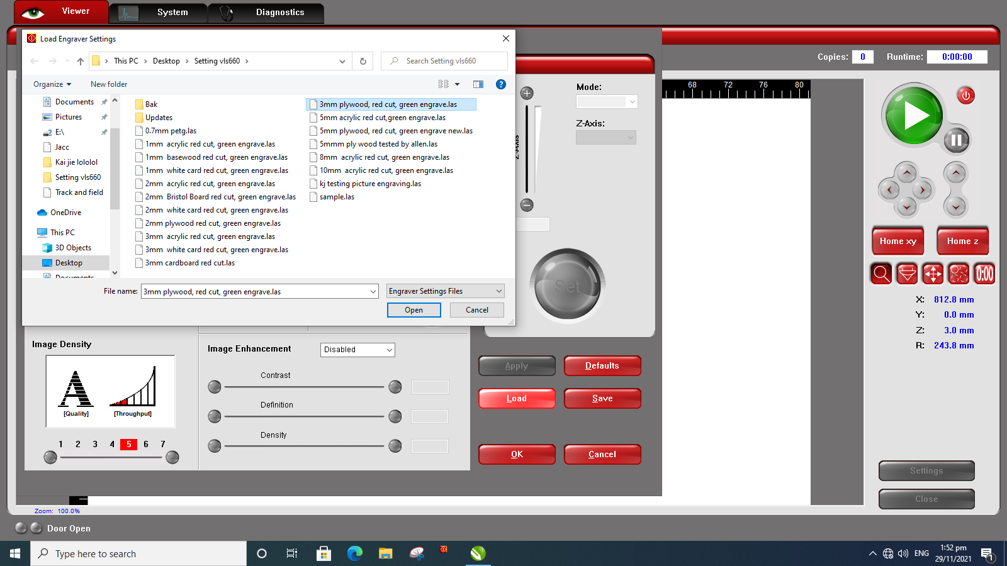
Step 6
A list will show up, select the material with the thickness you will be cutting and click “Open”.

Slide 11
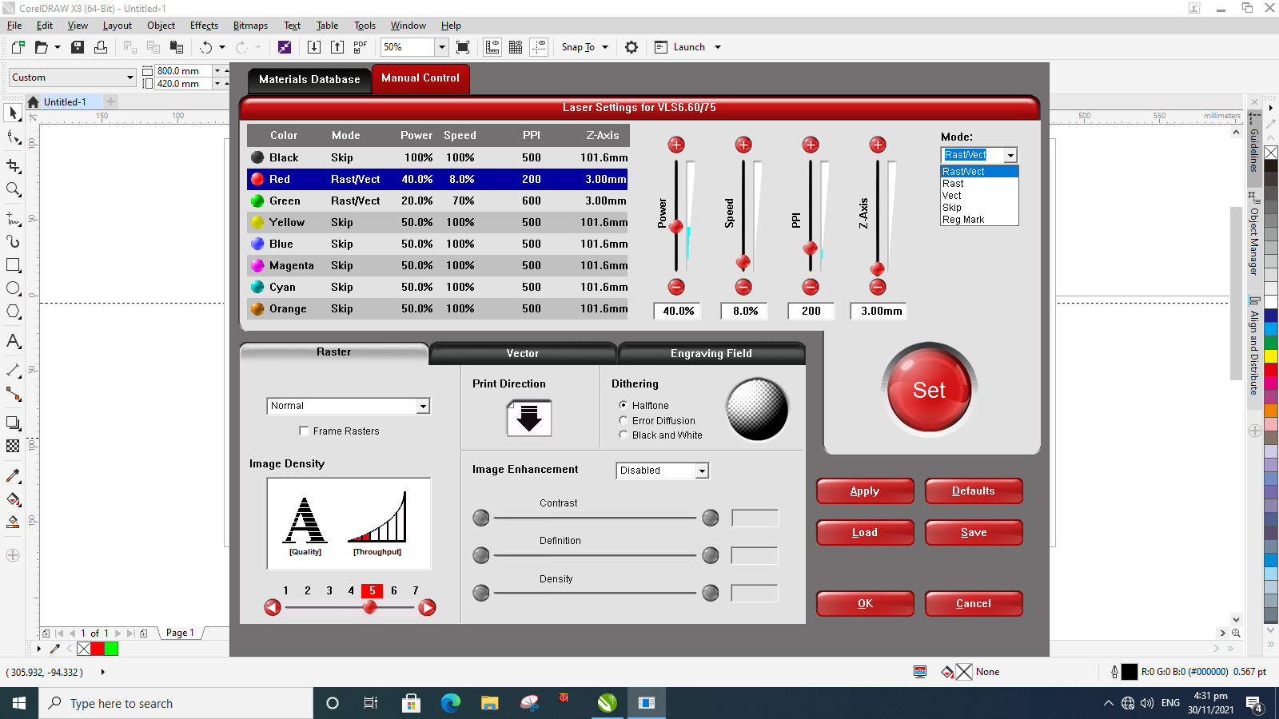
Step 7
You can change the power, speed, frequency and material thickness here. You can also re-define your cut profile here. (Usually red is for cutting, green for engraving). If you are satisfied with your settings, click “Set”. After changing each setting, click “Set” to save your settings. If you are satisfied with all the settings, click “Save”.

Slide 12
Step 8
When you are ready, click “Print”.

Slide 13
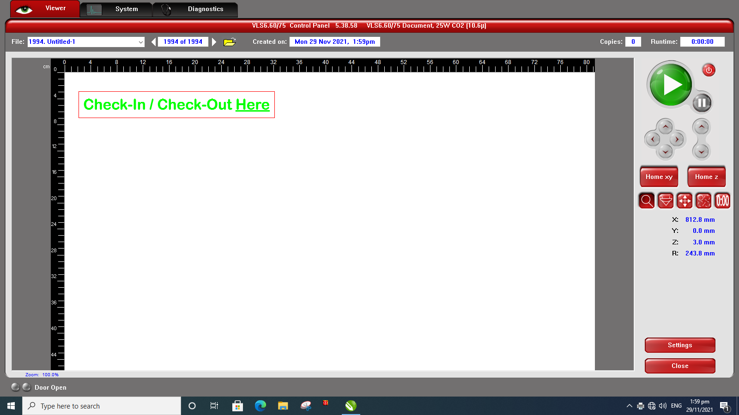
Step 9
You will be guided to this platform. If this does not automatically show up, you can go into it by clicking the red icon in the task bar.

Slide 14
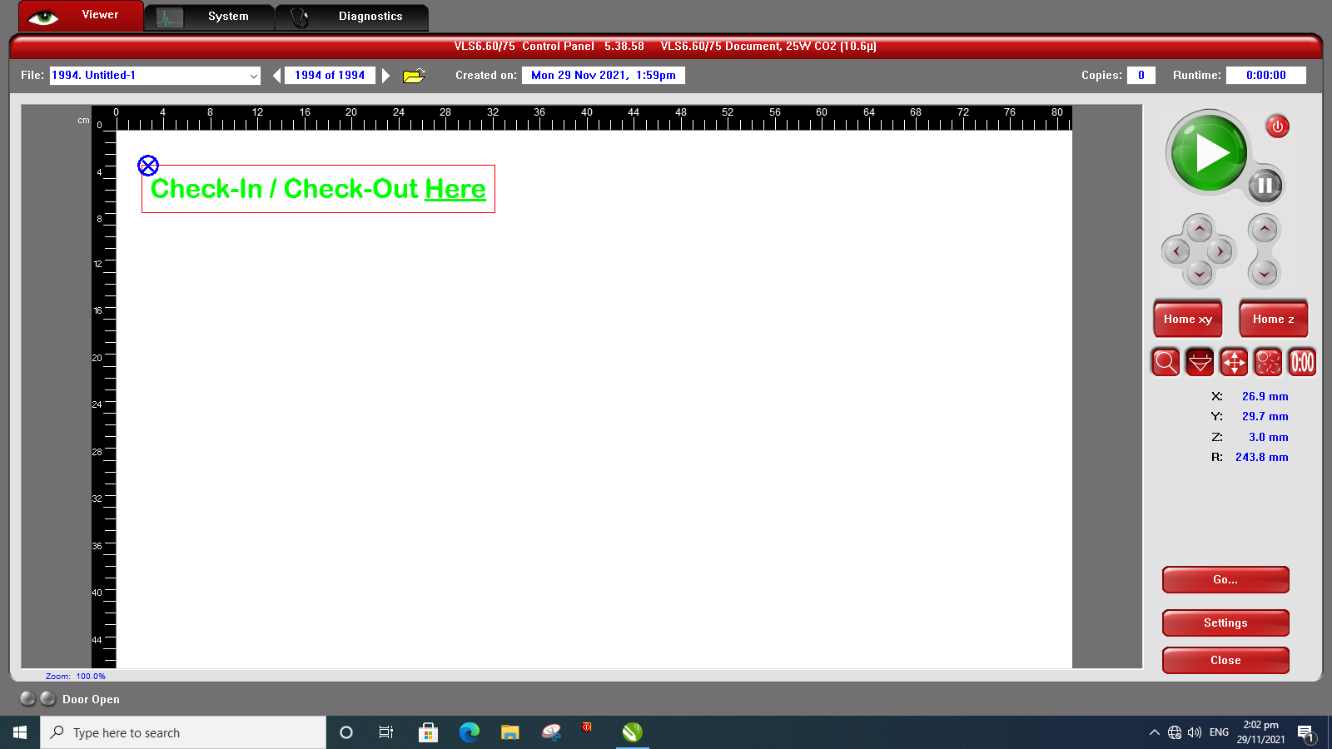
Step 10
Use the focus view to move the laser pointer and see where your drawing is on the material. It is necessary to do this before cutting.
Laser Pointer Position
Focus View

Slide 15
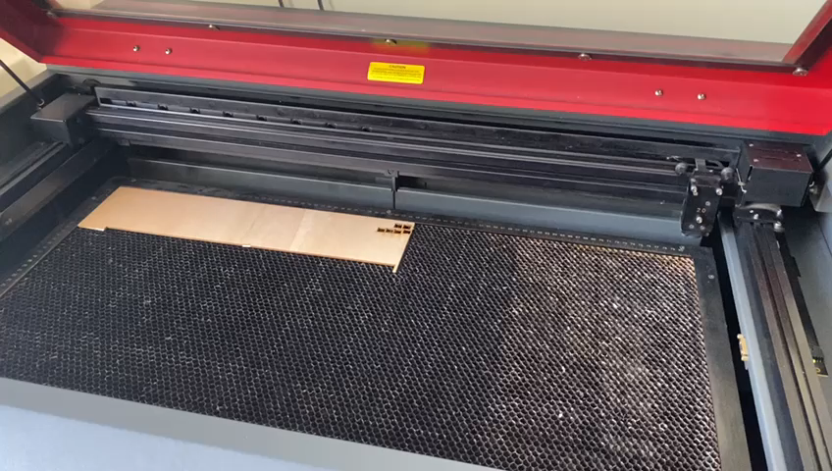
When you click at a point in the computer, the laser pointer will move to that point.

Slide 16

Step 11
If you want to move your drawing, you can do this on this platform by clicking on “Relocate View” and moving it manually or……
Relocate View

Slide 17
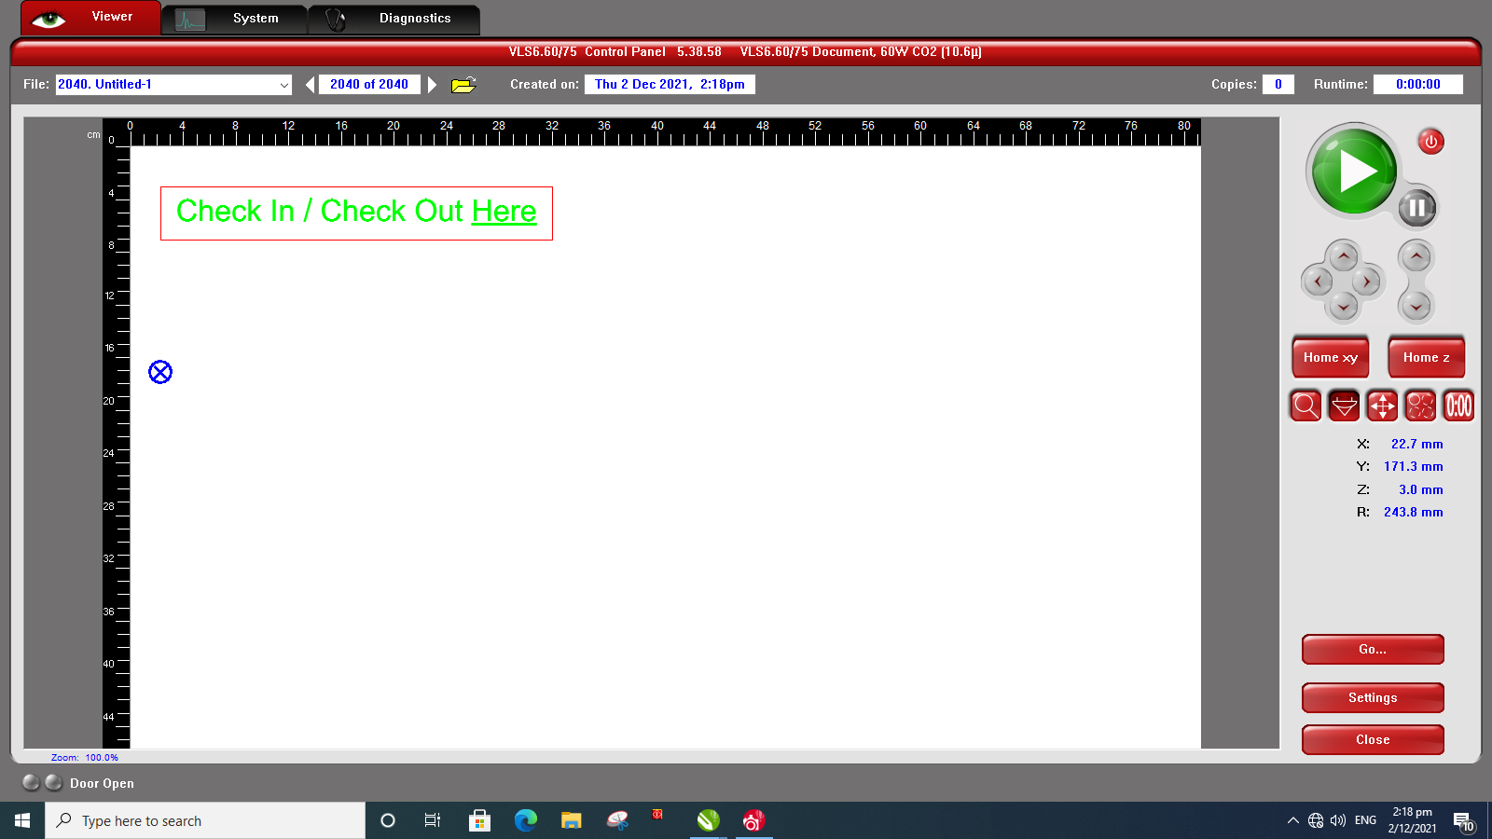
Step 12
Go to “Focus View”, move the laser pointer to the place you desire.

Slide 18
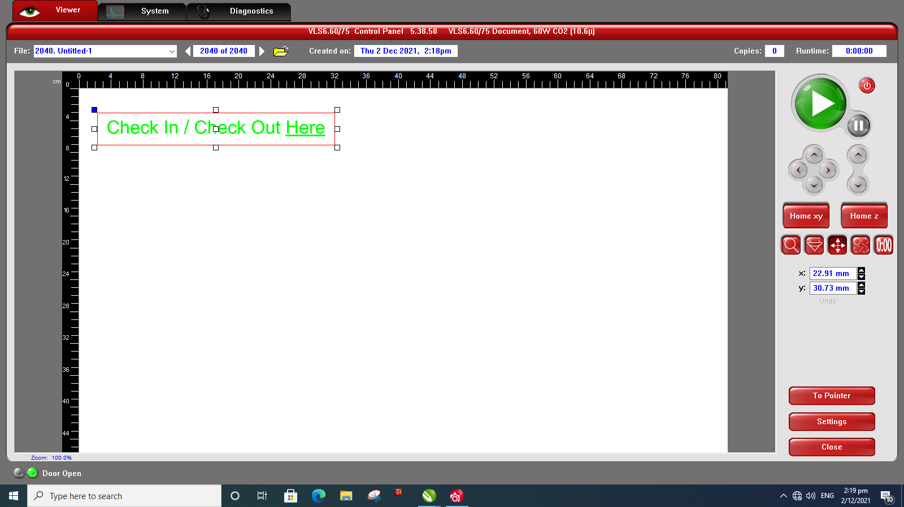
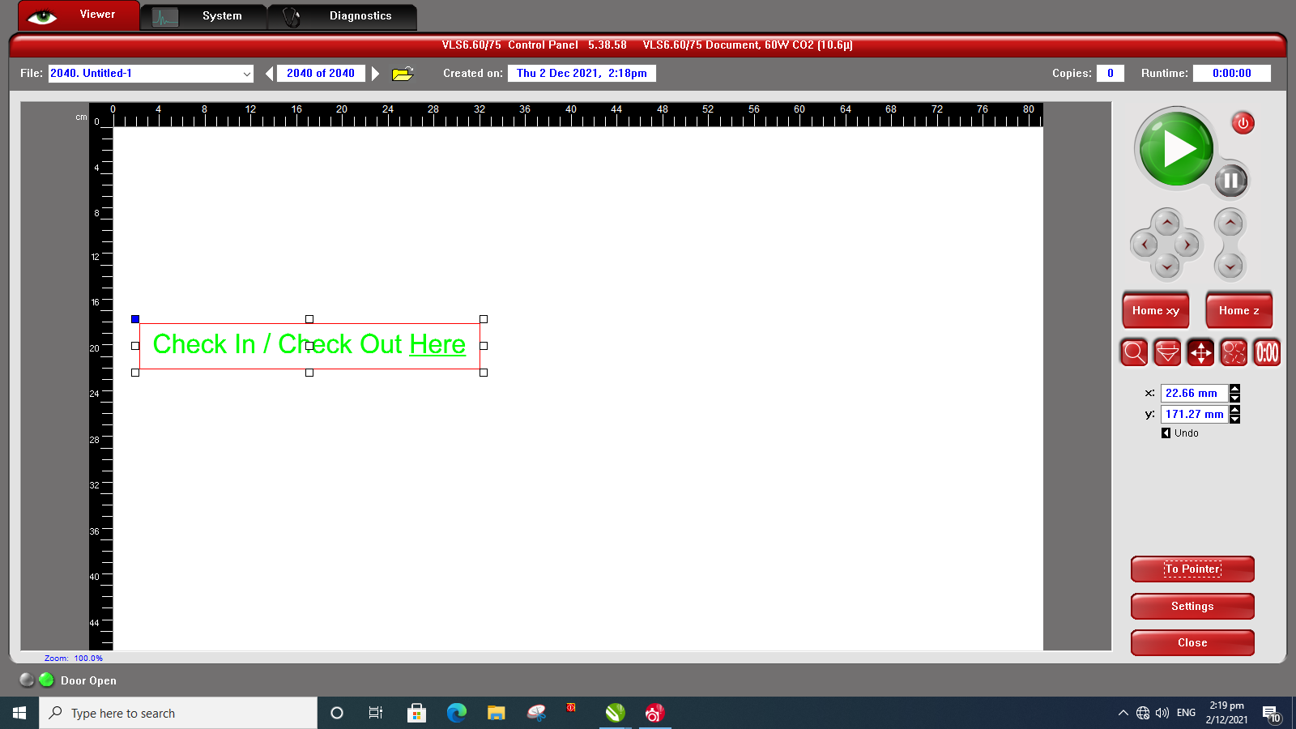
Step 13
Go to “Relocate View” again. Select a node from the picture then click “To Pointer” to move the selected node to the laser pointer.
Node

Slide 19
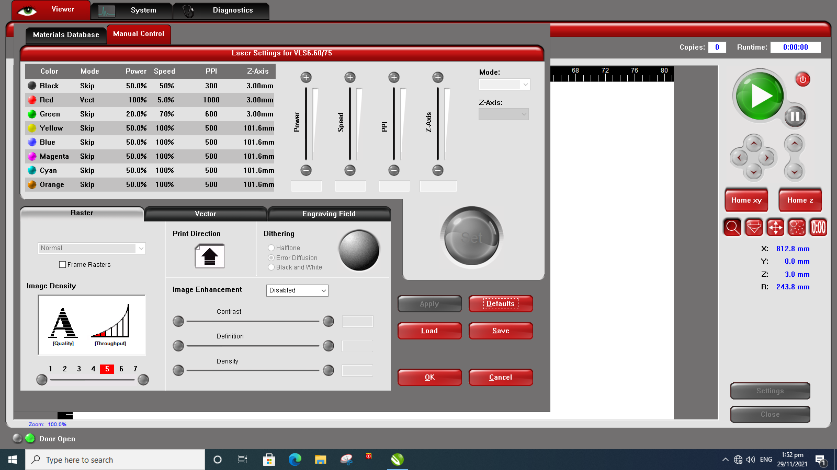
Step 14
You can also re-check the settings here by clicking the “Settings”.

Slide 20
Step 15
If you are satisfied with all the settings, you can close the laser cutter and click the “Start” button.

Slide 21
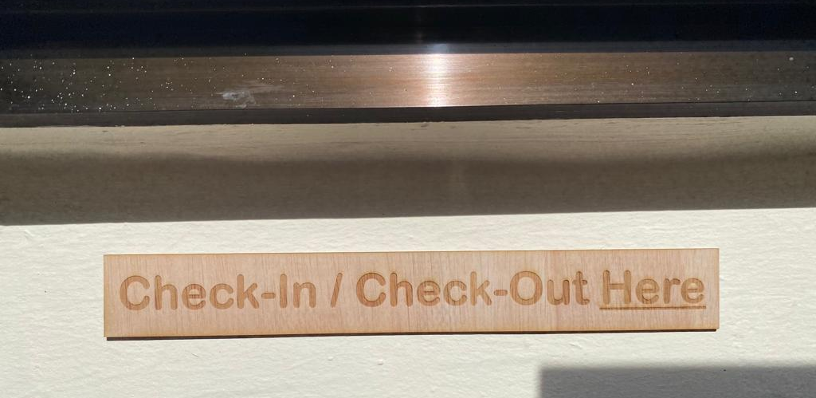
Step 16
Wait until the cutting has finished. When it’s done cutting, wait for about 30 sec to 1min then remove the material.

Slide 22
The End
Thank You

